Slide 1
Ivy Reid
UI/UX Designer // PORTFOLIO

Slide 2
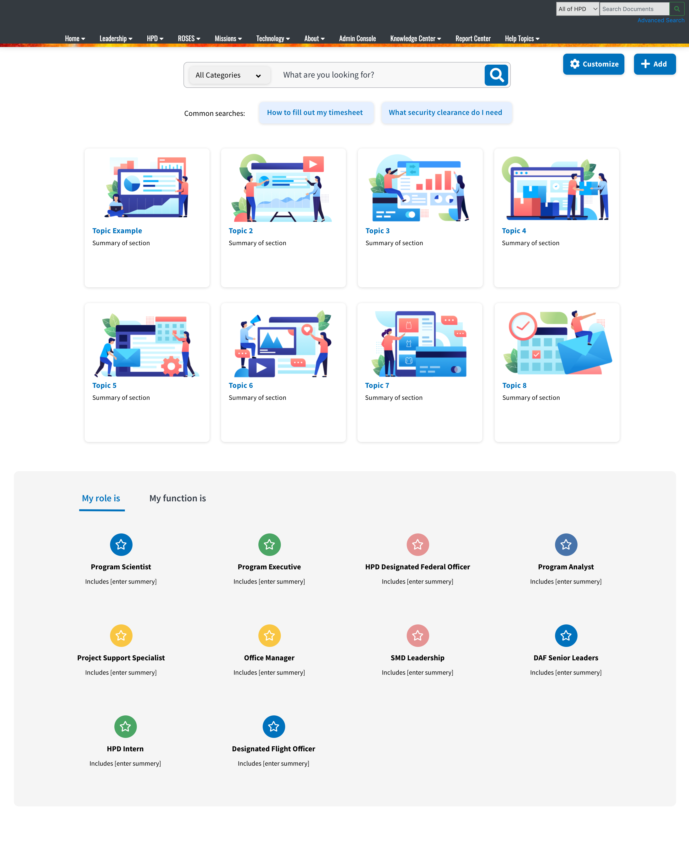
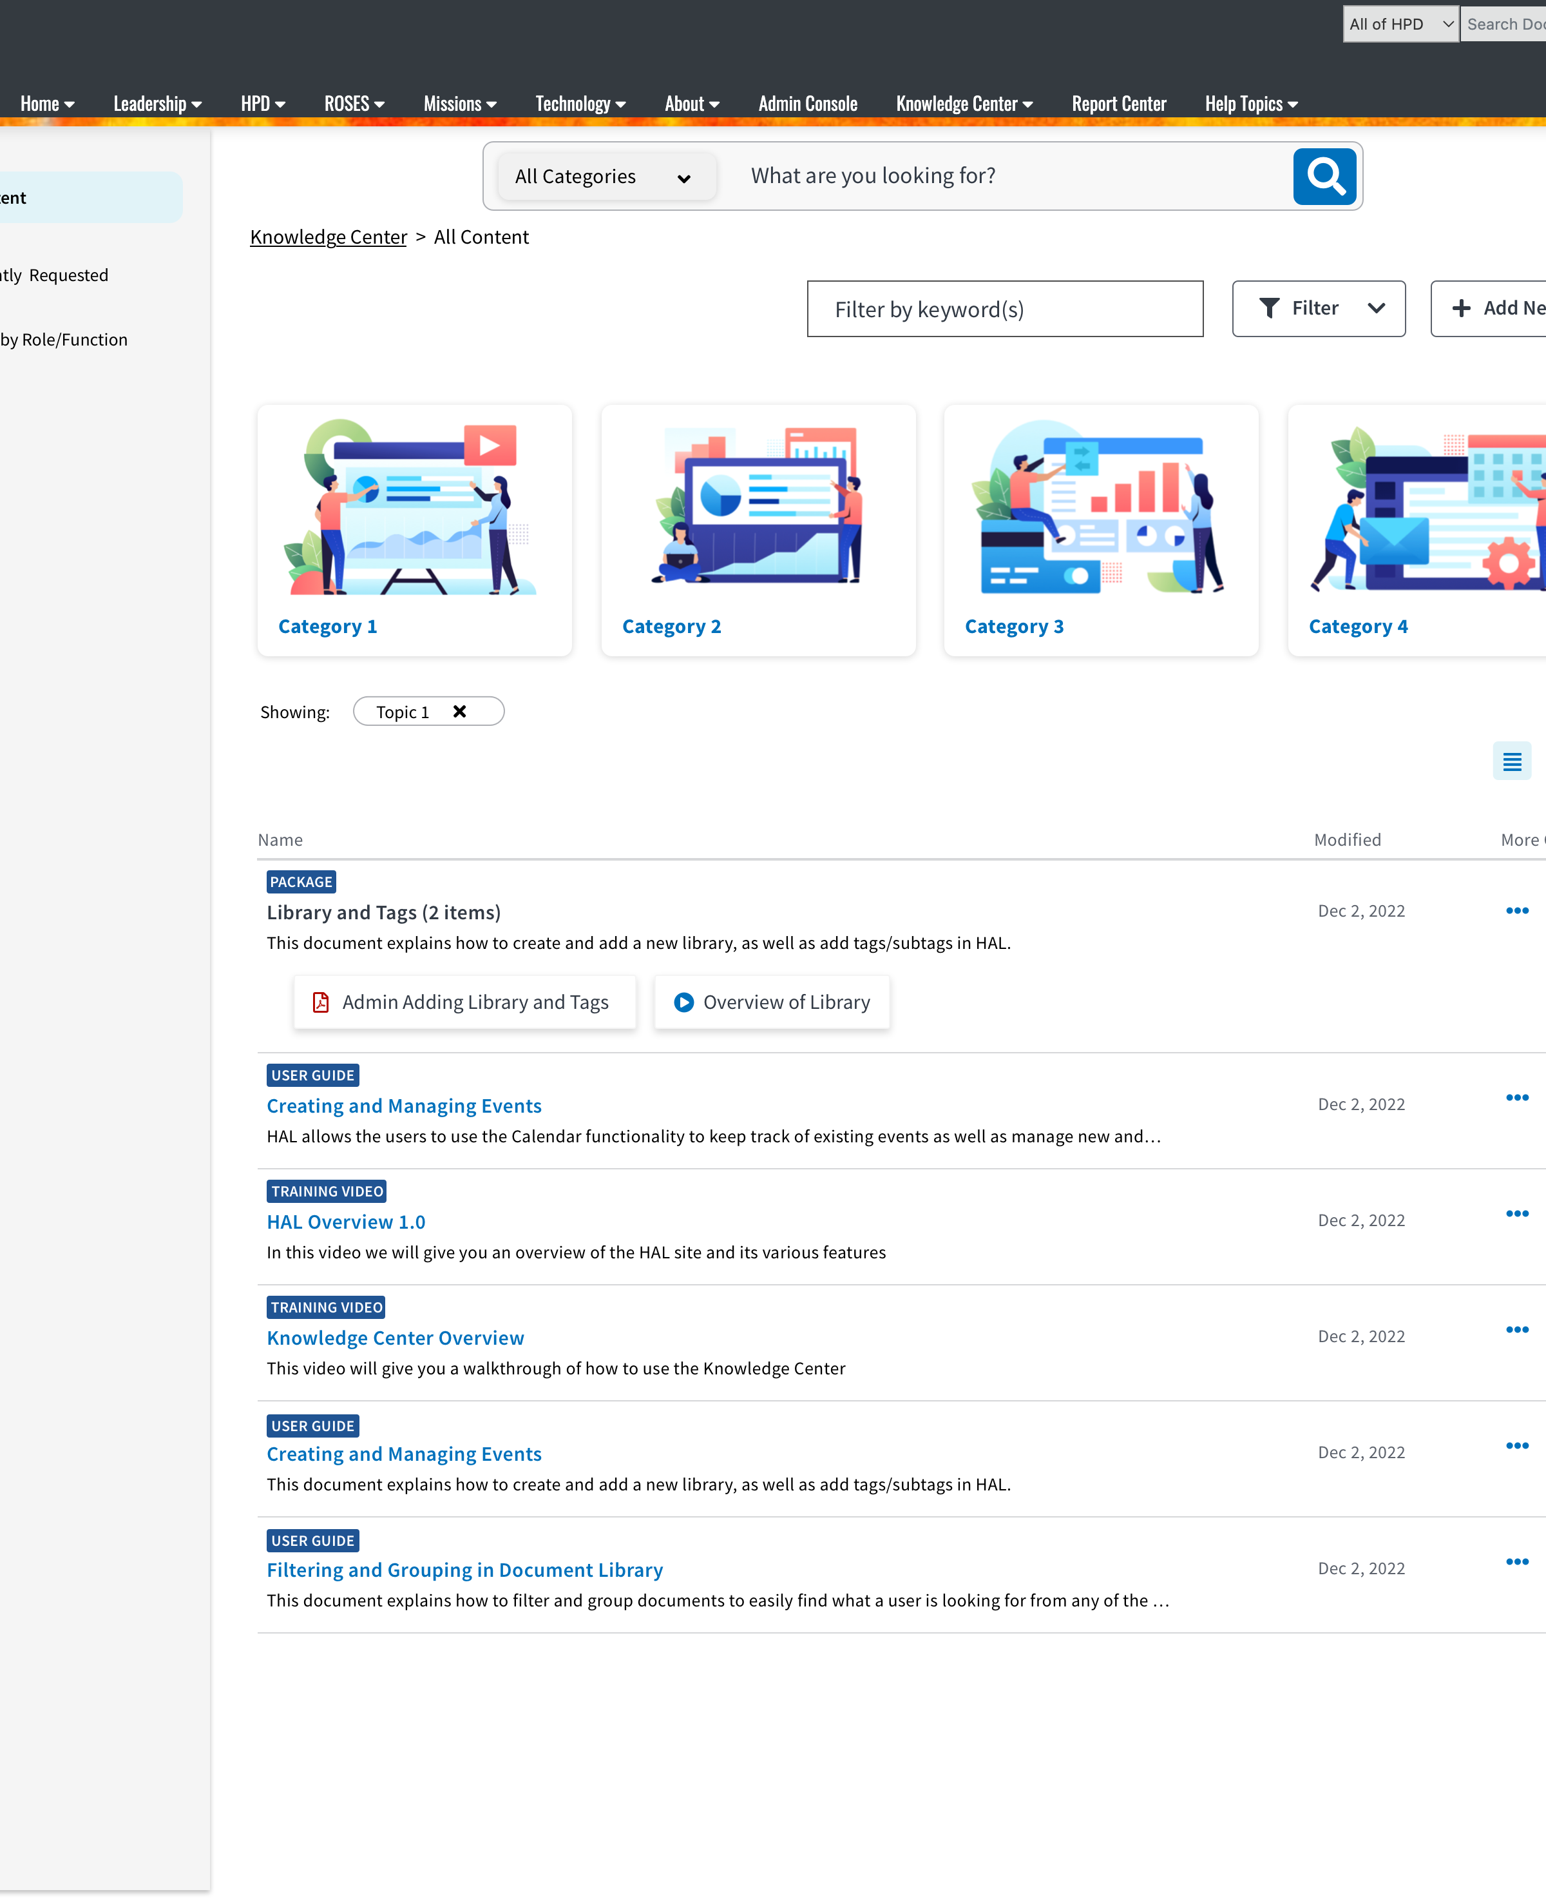
Knowledge base
UI/UX design
Client’s Knowledge Management Assessment provides access to data and related documentation, tools, and services of the Client’s research efforts.
I supported efforts to design a proof of concept of a new knowledge base for scientists as they onboard, train and navigate through their roles.

Slide 3
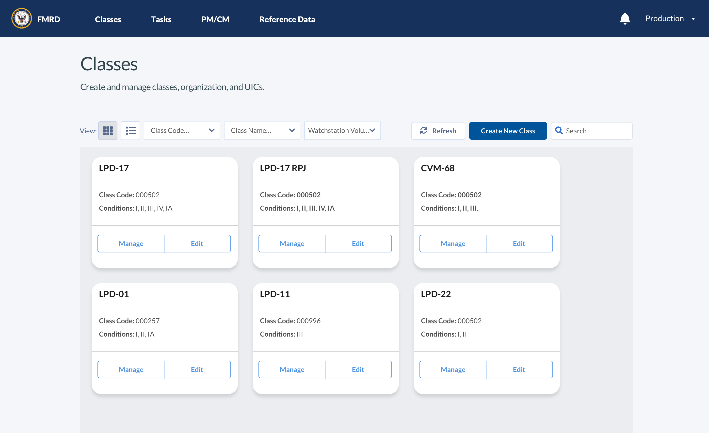
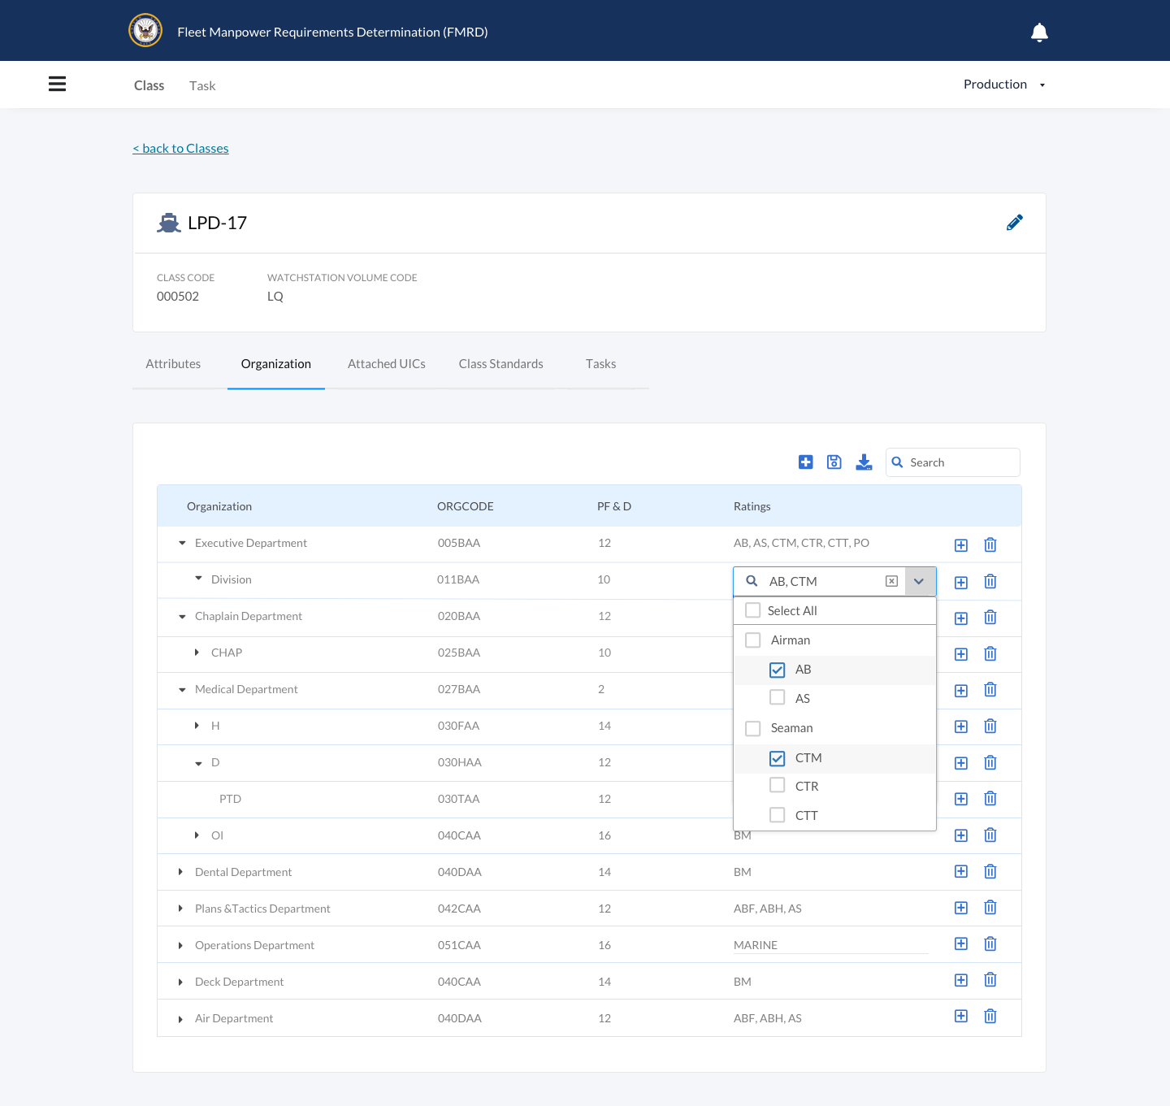
Gov Application
UI/UX design
This is an application report that provides the manpower requirements for a Shore or Sea Command.
We supported efforts to redesign and build a new application replacing their antiquated system.
I supported these efforts through wireframe creation and user testing.

Slide 4
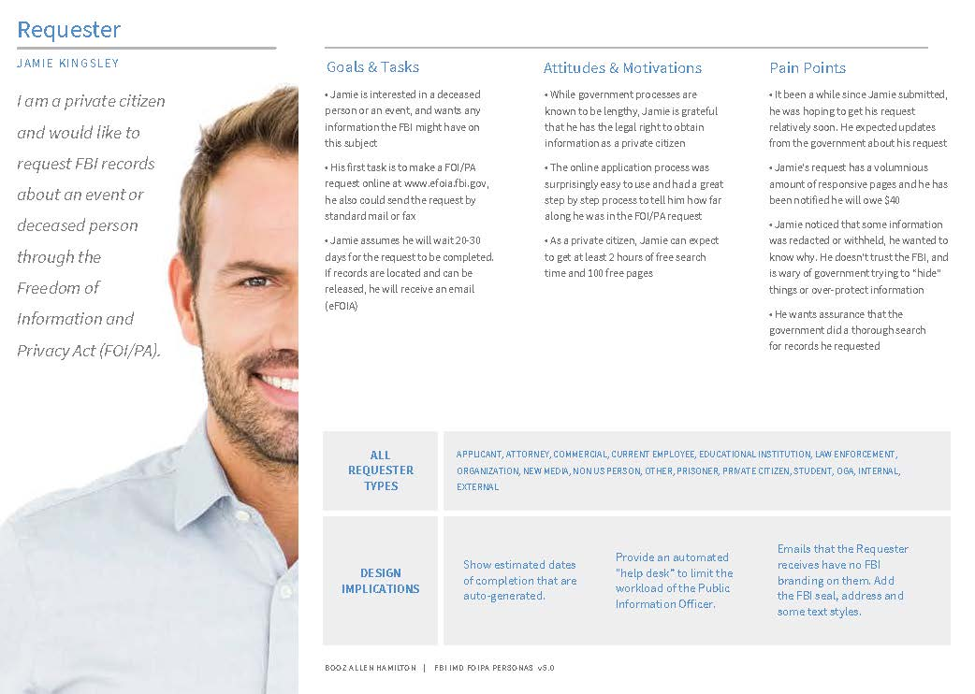
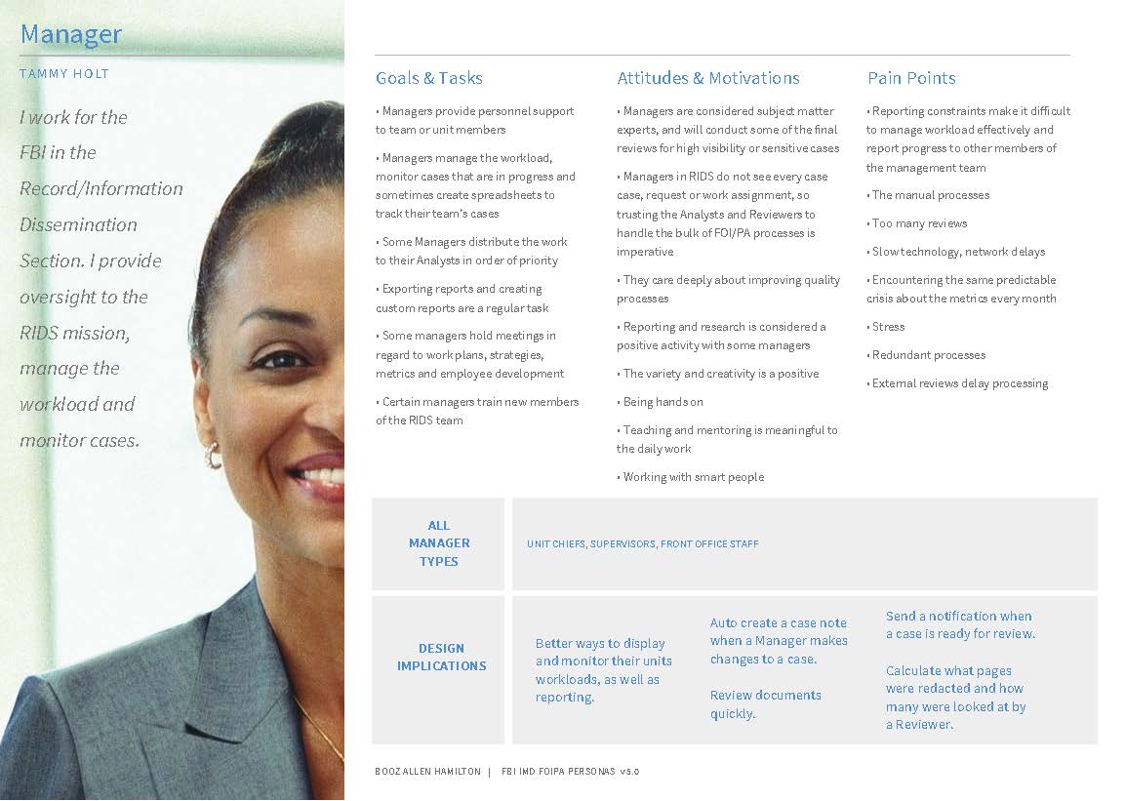
Gov Application
UI/UX design, user research
The government agency manages case database representing active cases.
We supported efforts to customize the application and an outside redaction tool so that it meets the needs of the client and follows branding and styling guidelines.
In addition, we developed personas, journey maps, and conducted user research.

Slide 5
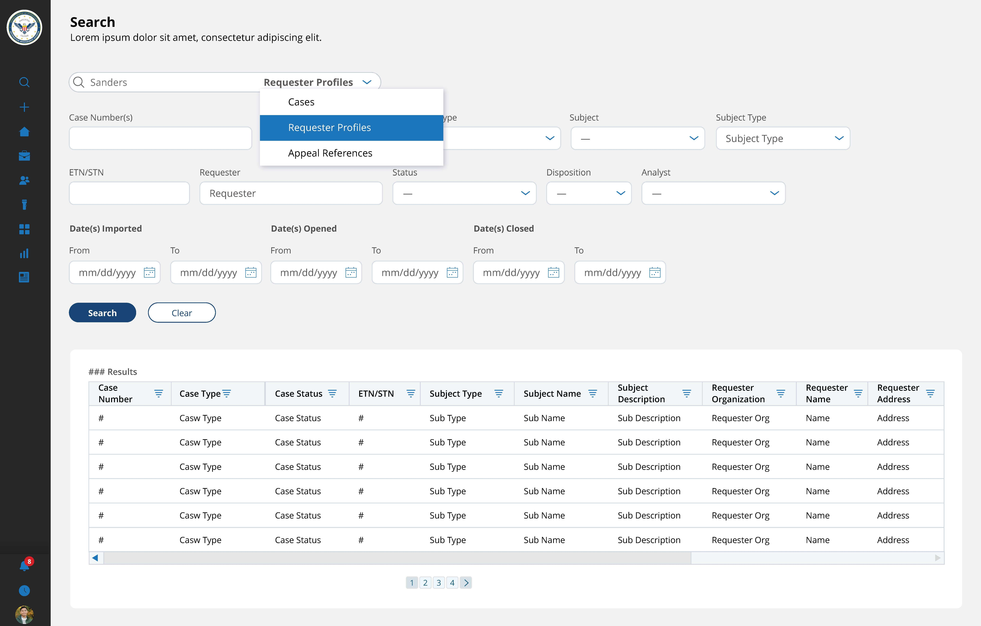
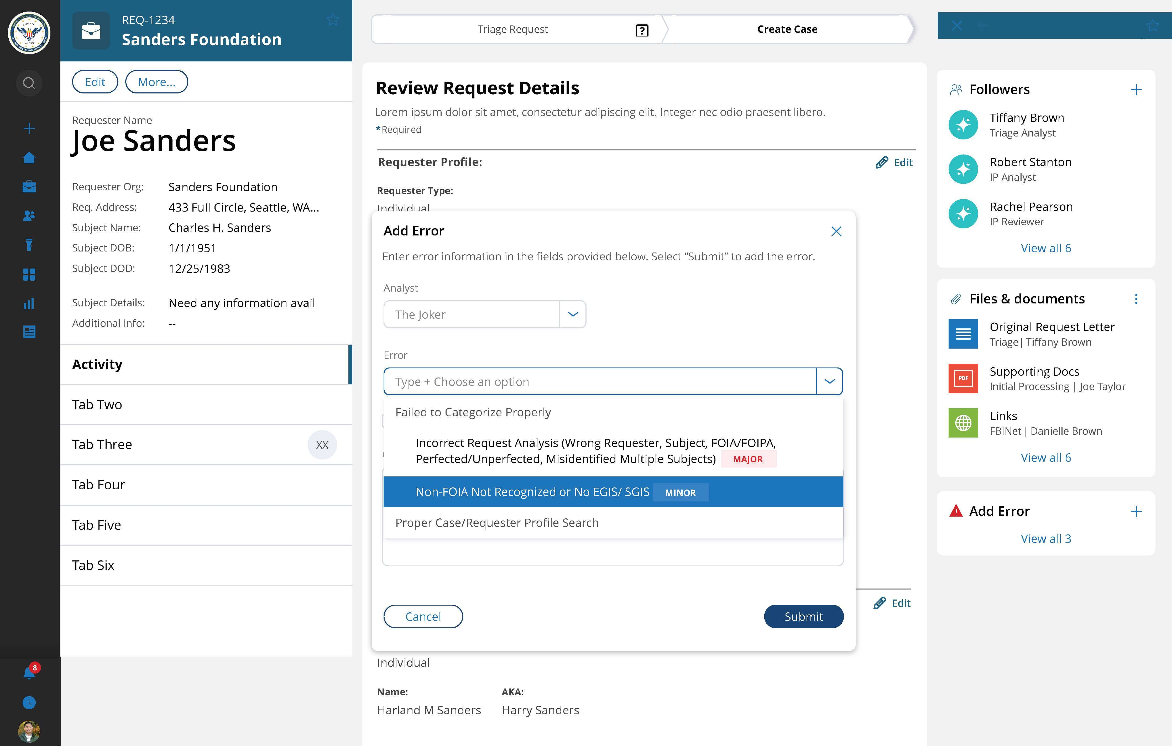
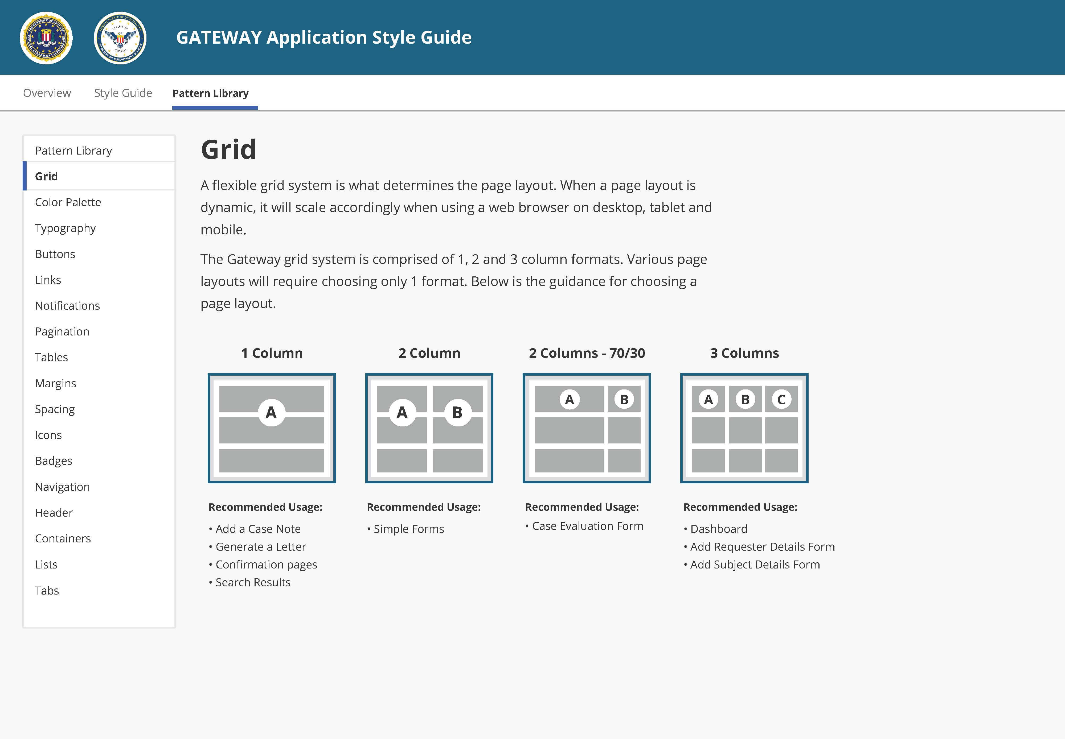
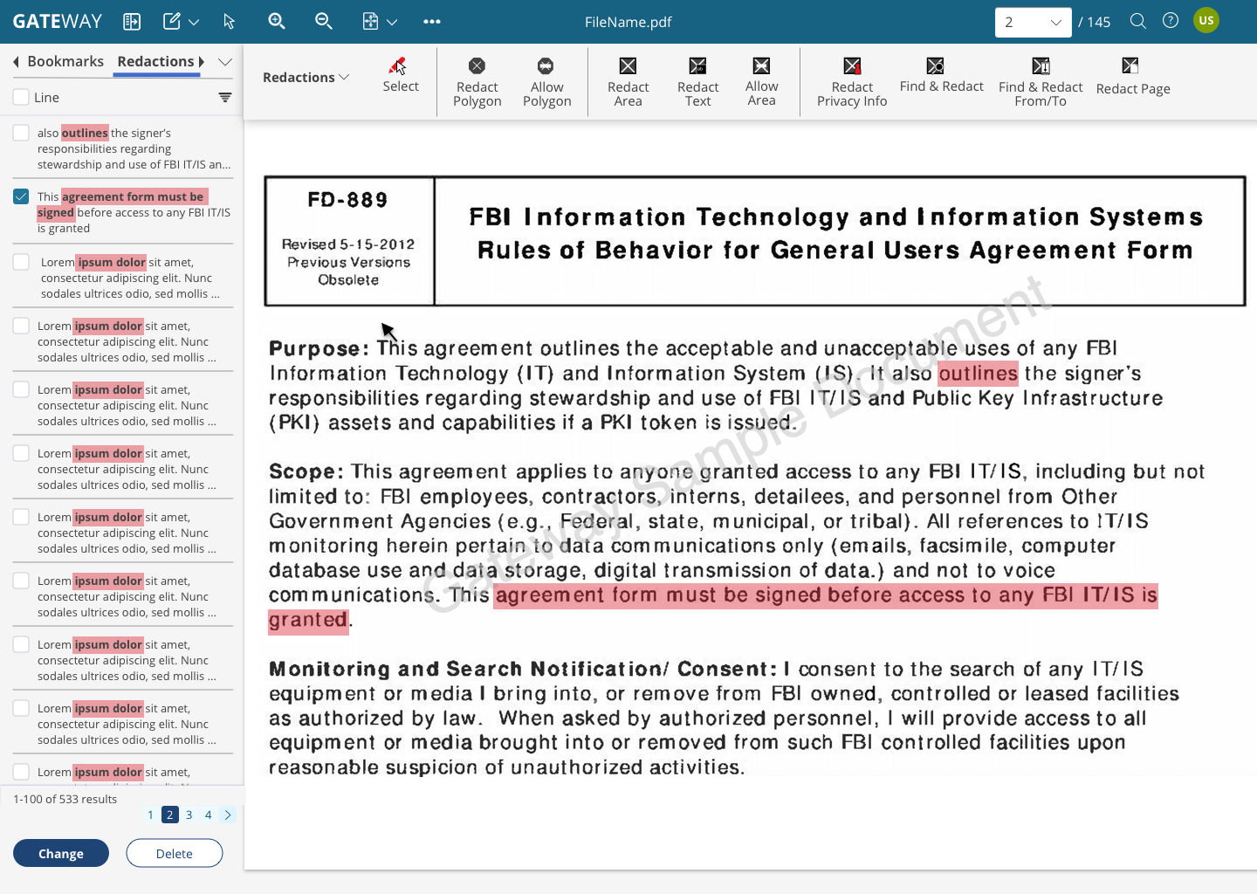
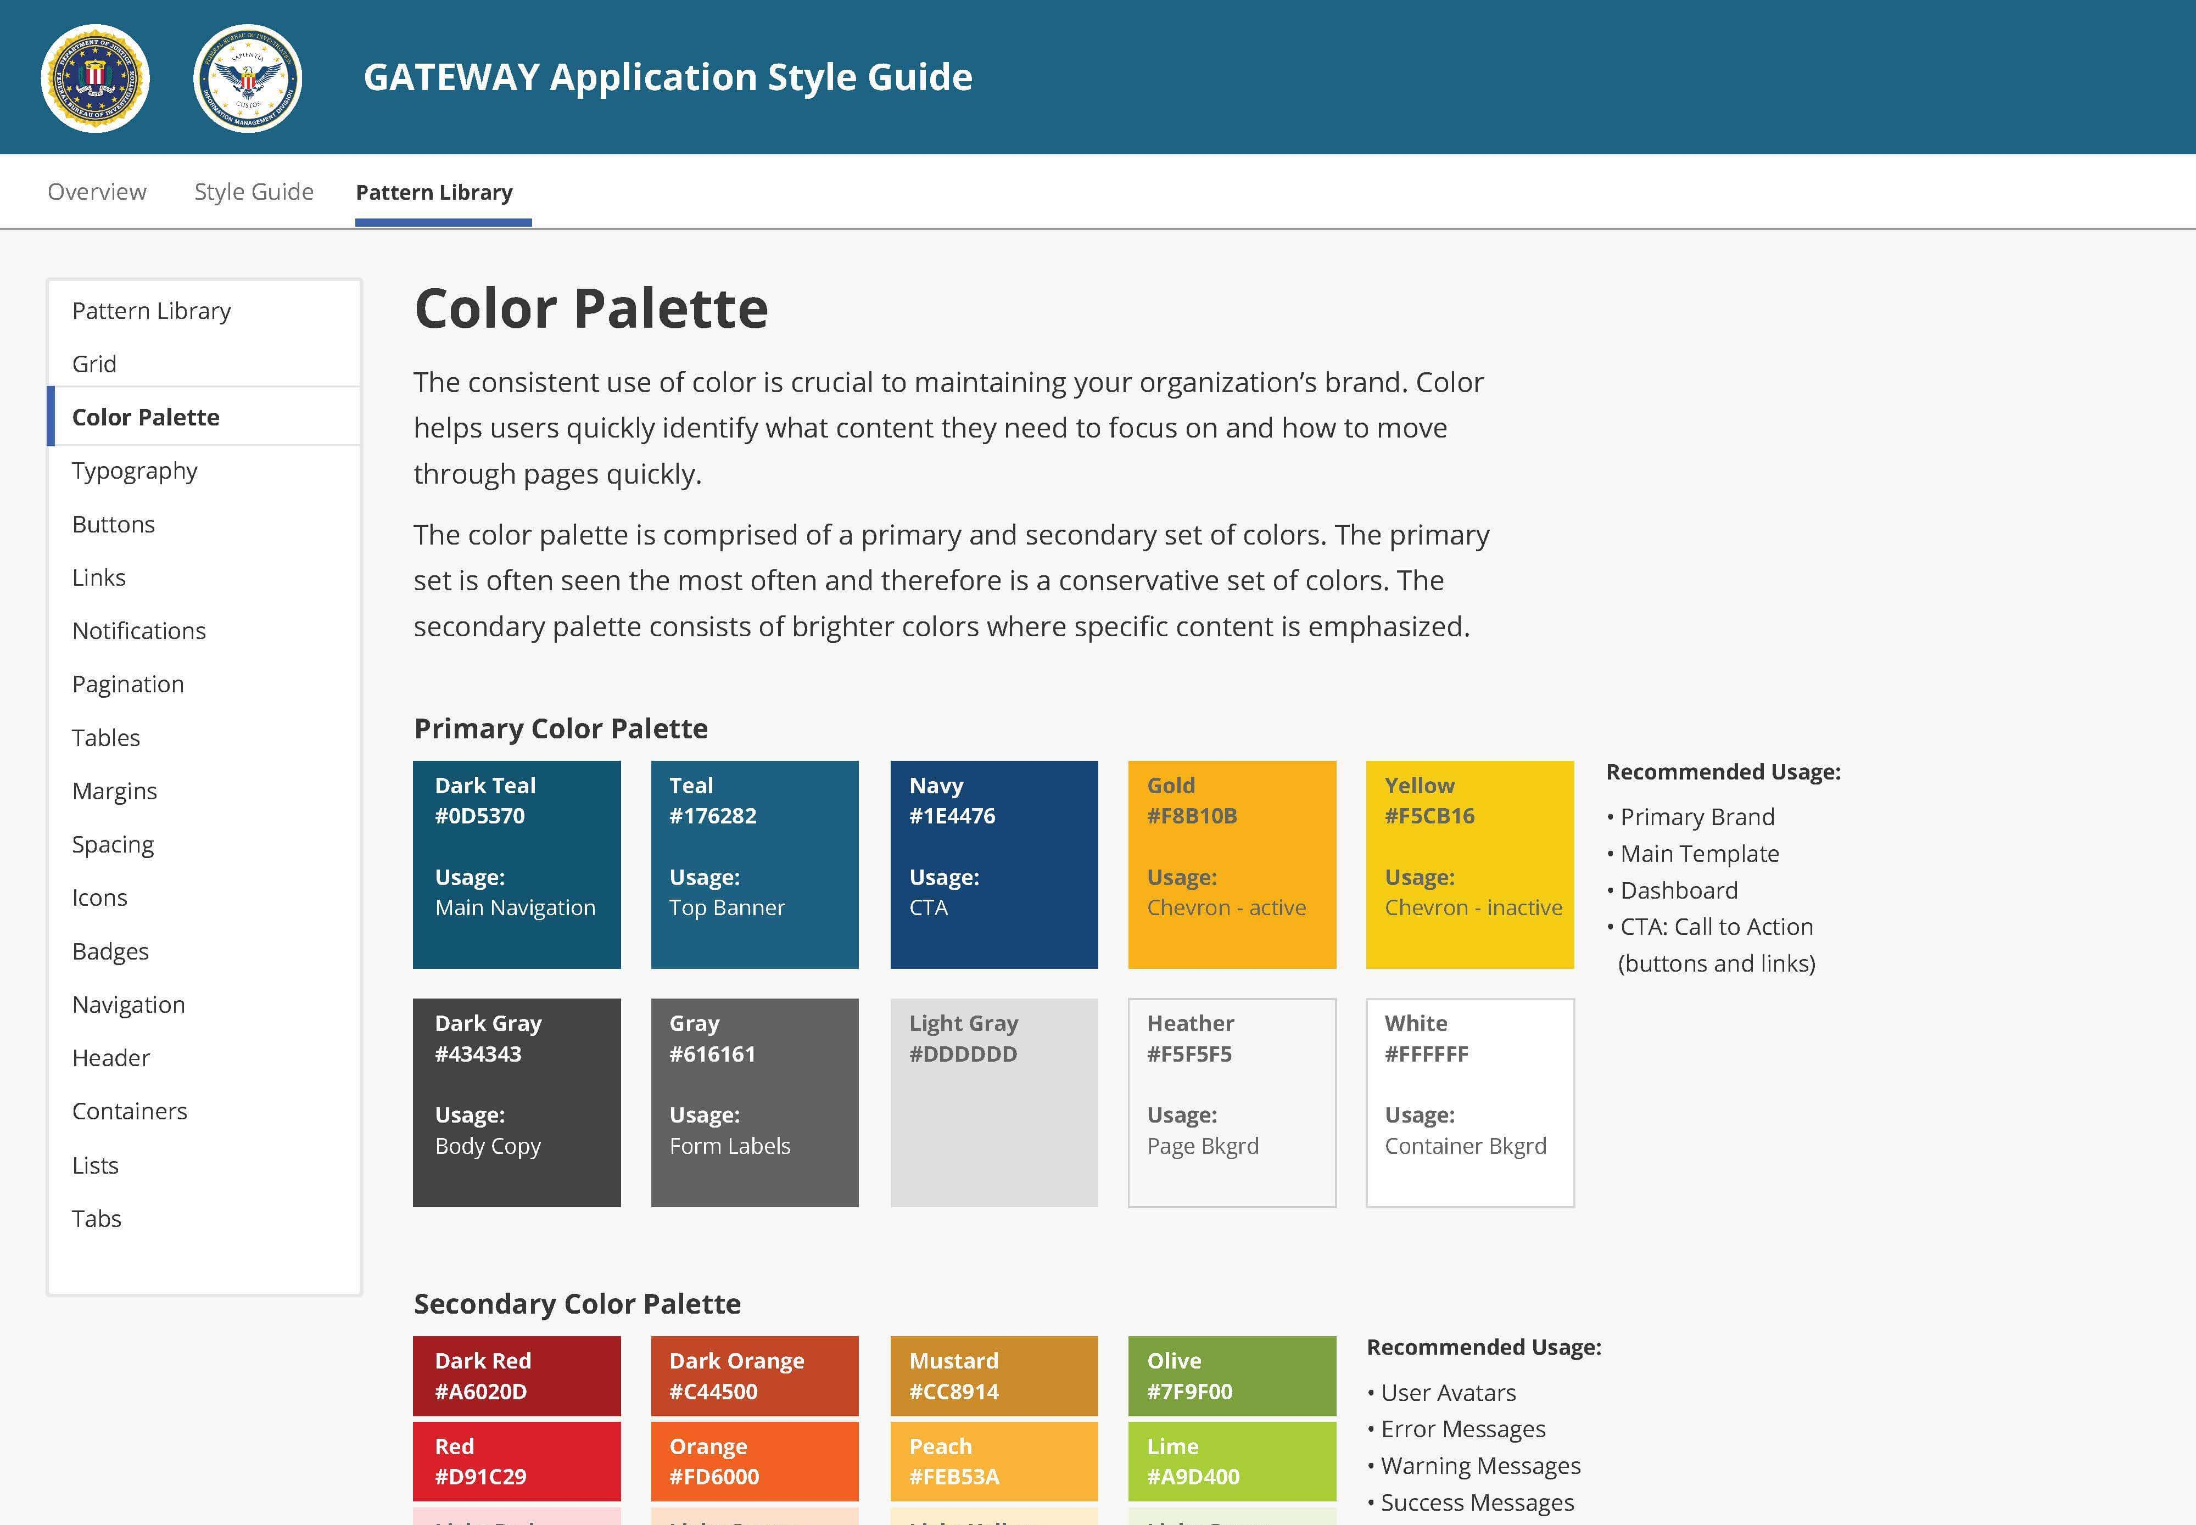
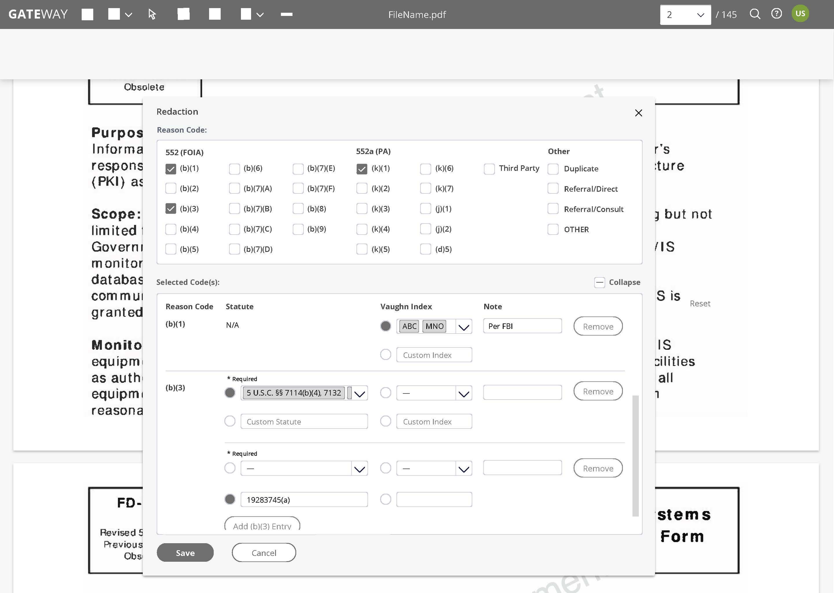
Gov Application
UI/UX design, user research
Created wireframes for desktop screens. Through the wireframes I was able to design user flows, navigation, and interactions. The wireframes were annotation for clarity and technical details.
We conducted usability testing sessions with real users. The knowledge gained from these usability tests validated information gathered during discovery and challenged some design decisions.

Slide 6
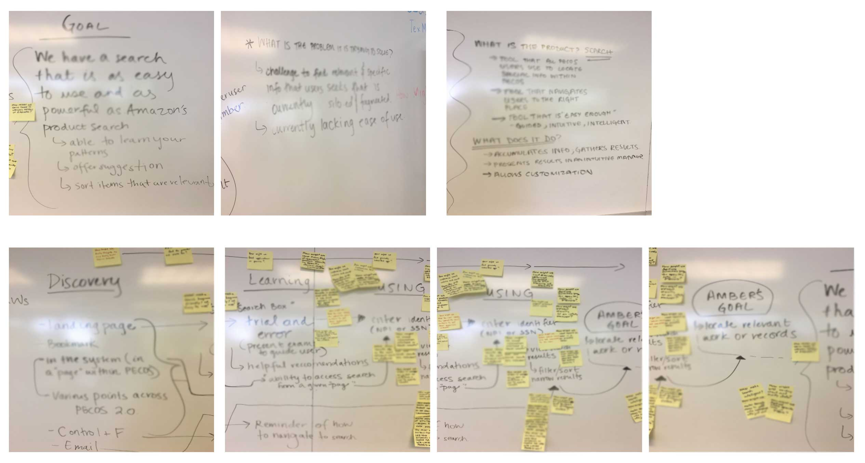
CMS PECOS Project
UX design
The project supports a healthcare enrollment process by allowing registered users to securely and electronically submit and manage healthcare enrollment information.
I conducted multiple discovery session that included users, product owners, subject matter experts and key stakeholders. Through user interviews, focus groups and design thinking sessions my team was able to provide suggested product enhancements. This list included features that the users found helpful, but our client was missing.

Slide 7
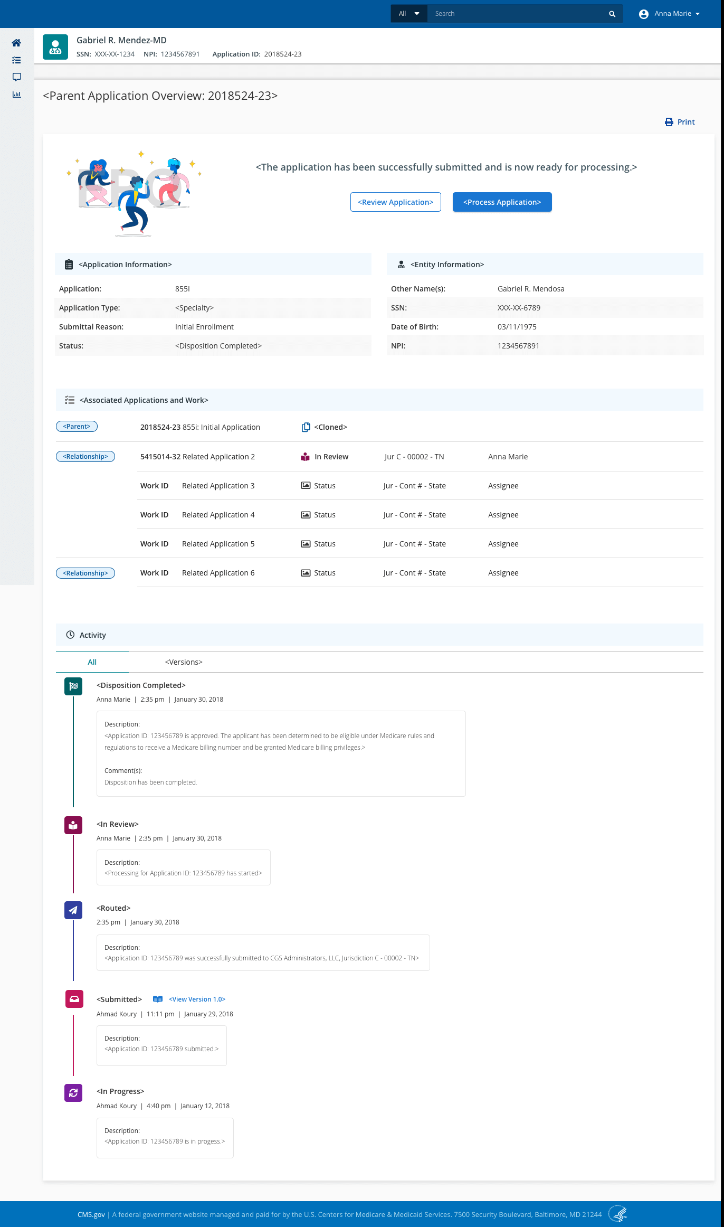
CMS PECOS DESIGN SYSTEM
UI design
I helped evolve the product and tailored it for our end users and to support business objectives. This involved creating a new user interface and design system and defining and implementing new functionality.
The design systems enabled teams to build a better product faster by making design reusable as reusability makes scaling possible.

Slide 8
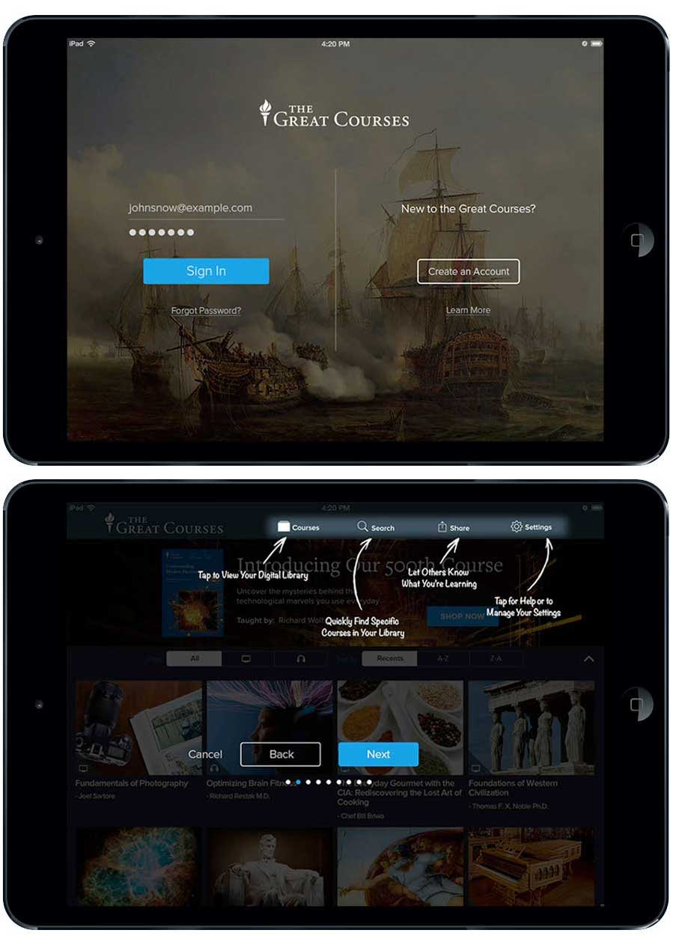
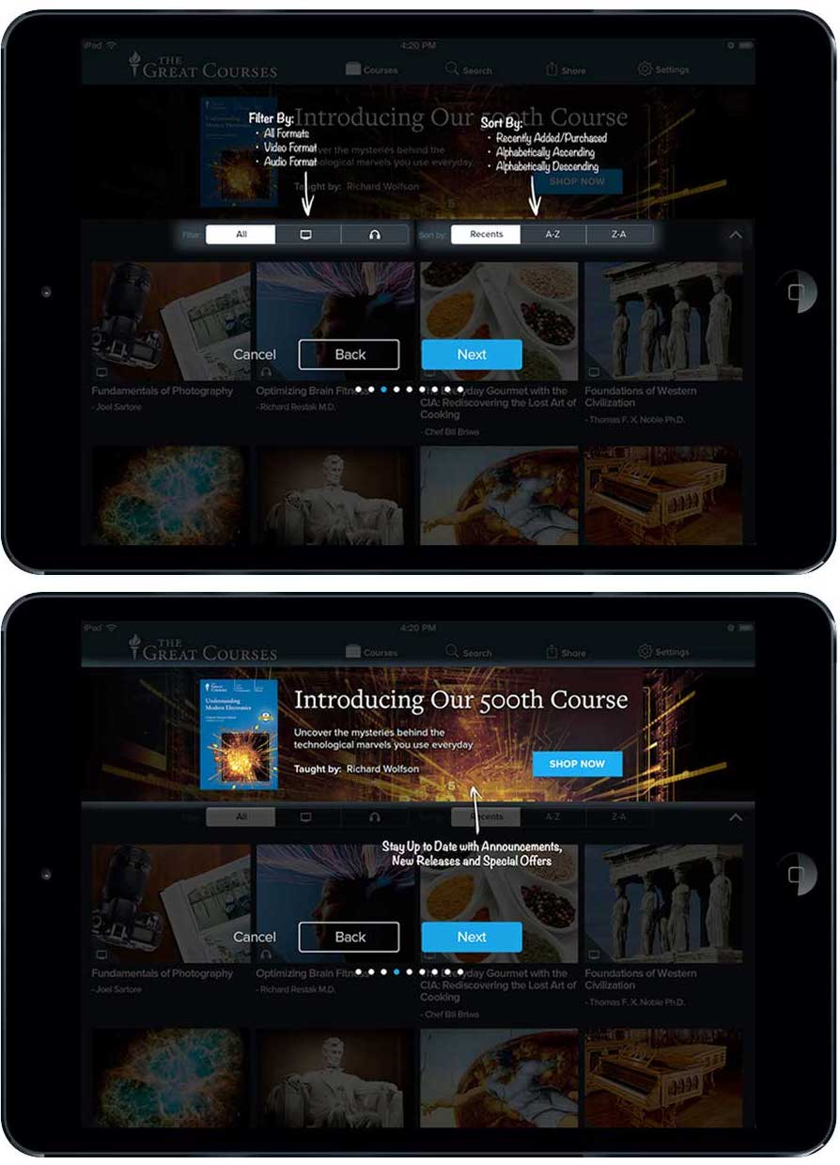
The Teaching Company The Great Courses APP
UI/UX design
The launch of a newly redesigned mobile app led to the need to ensure users could quickly learn this new experience. I created a tutorial for new and existing users to learn how to best navigate, download and consumer their products.

Slide 9
GTMP WEFT IT APP
UI/UX design
Rebrand of site converting email recipients to sign up for health insurance.
The redesign led to a 23% increased conversion rate.

Slide 10
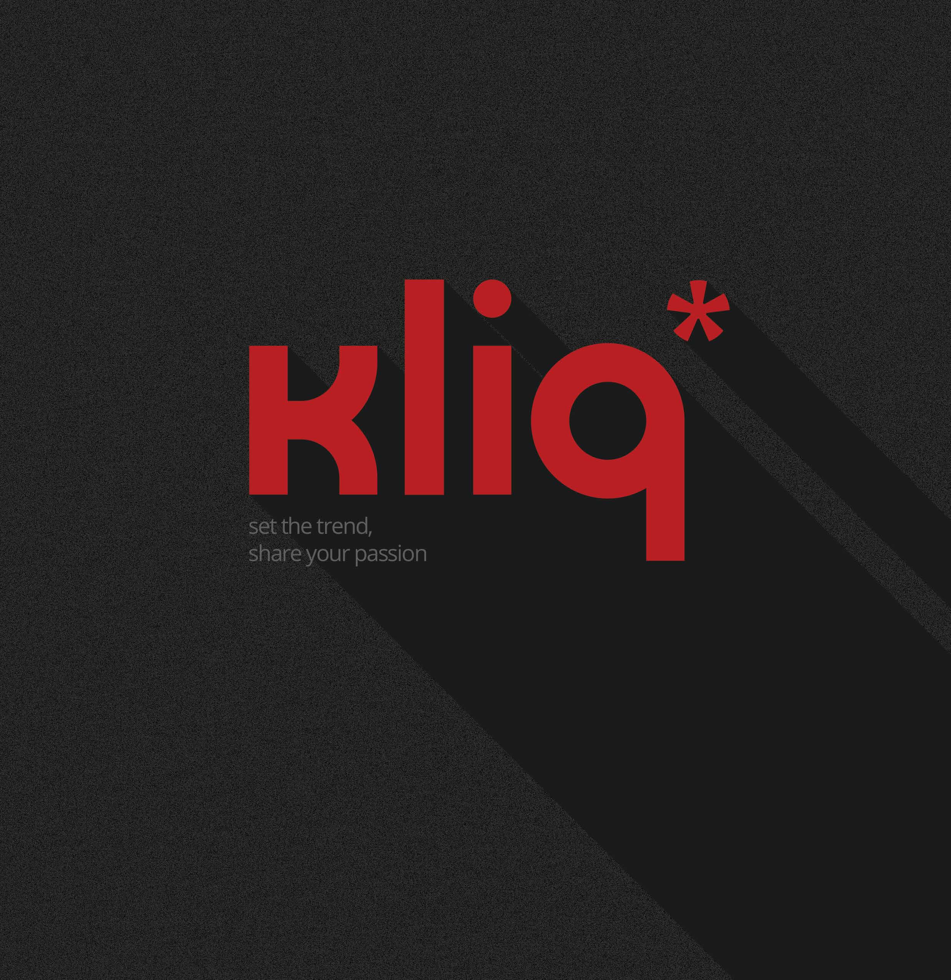
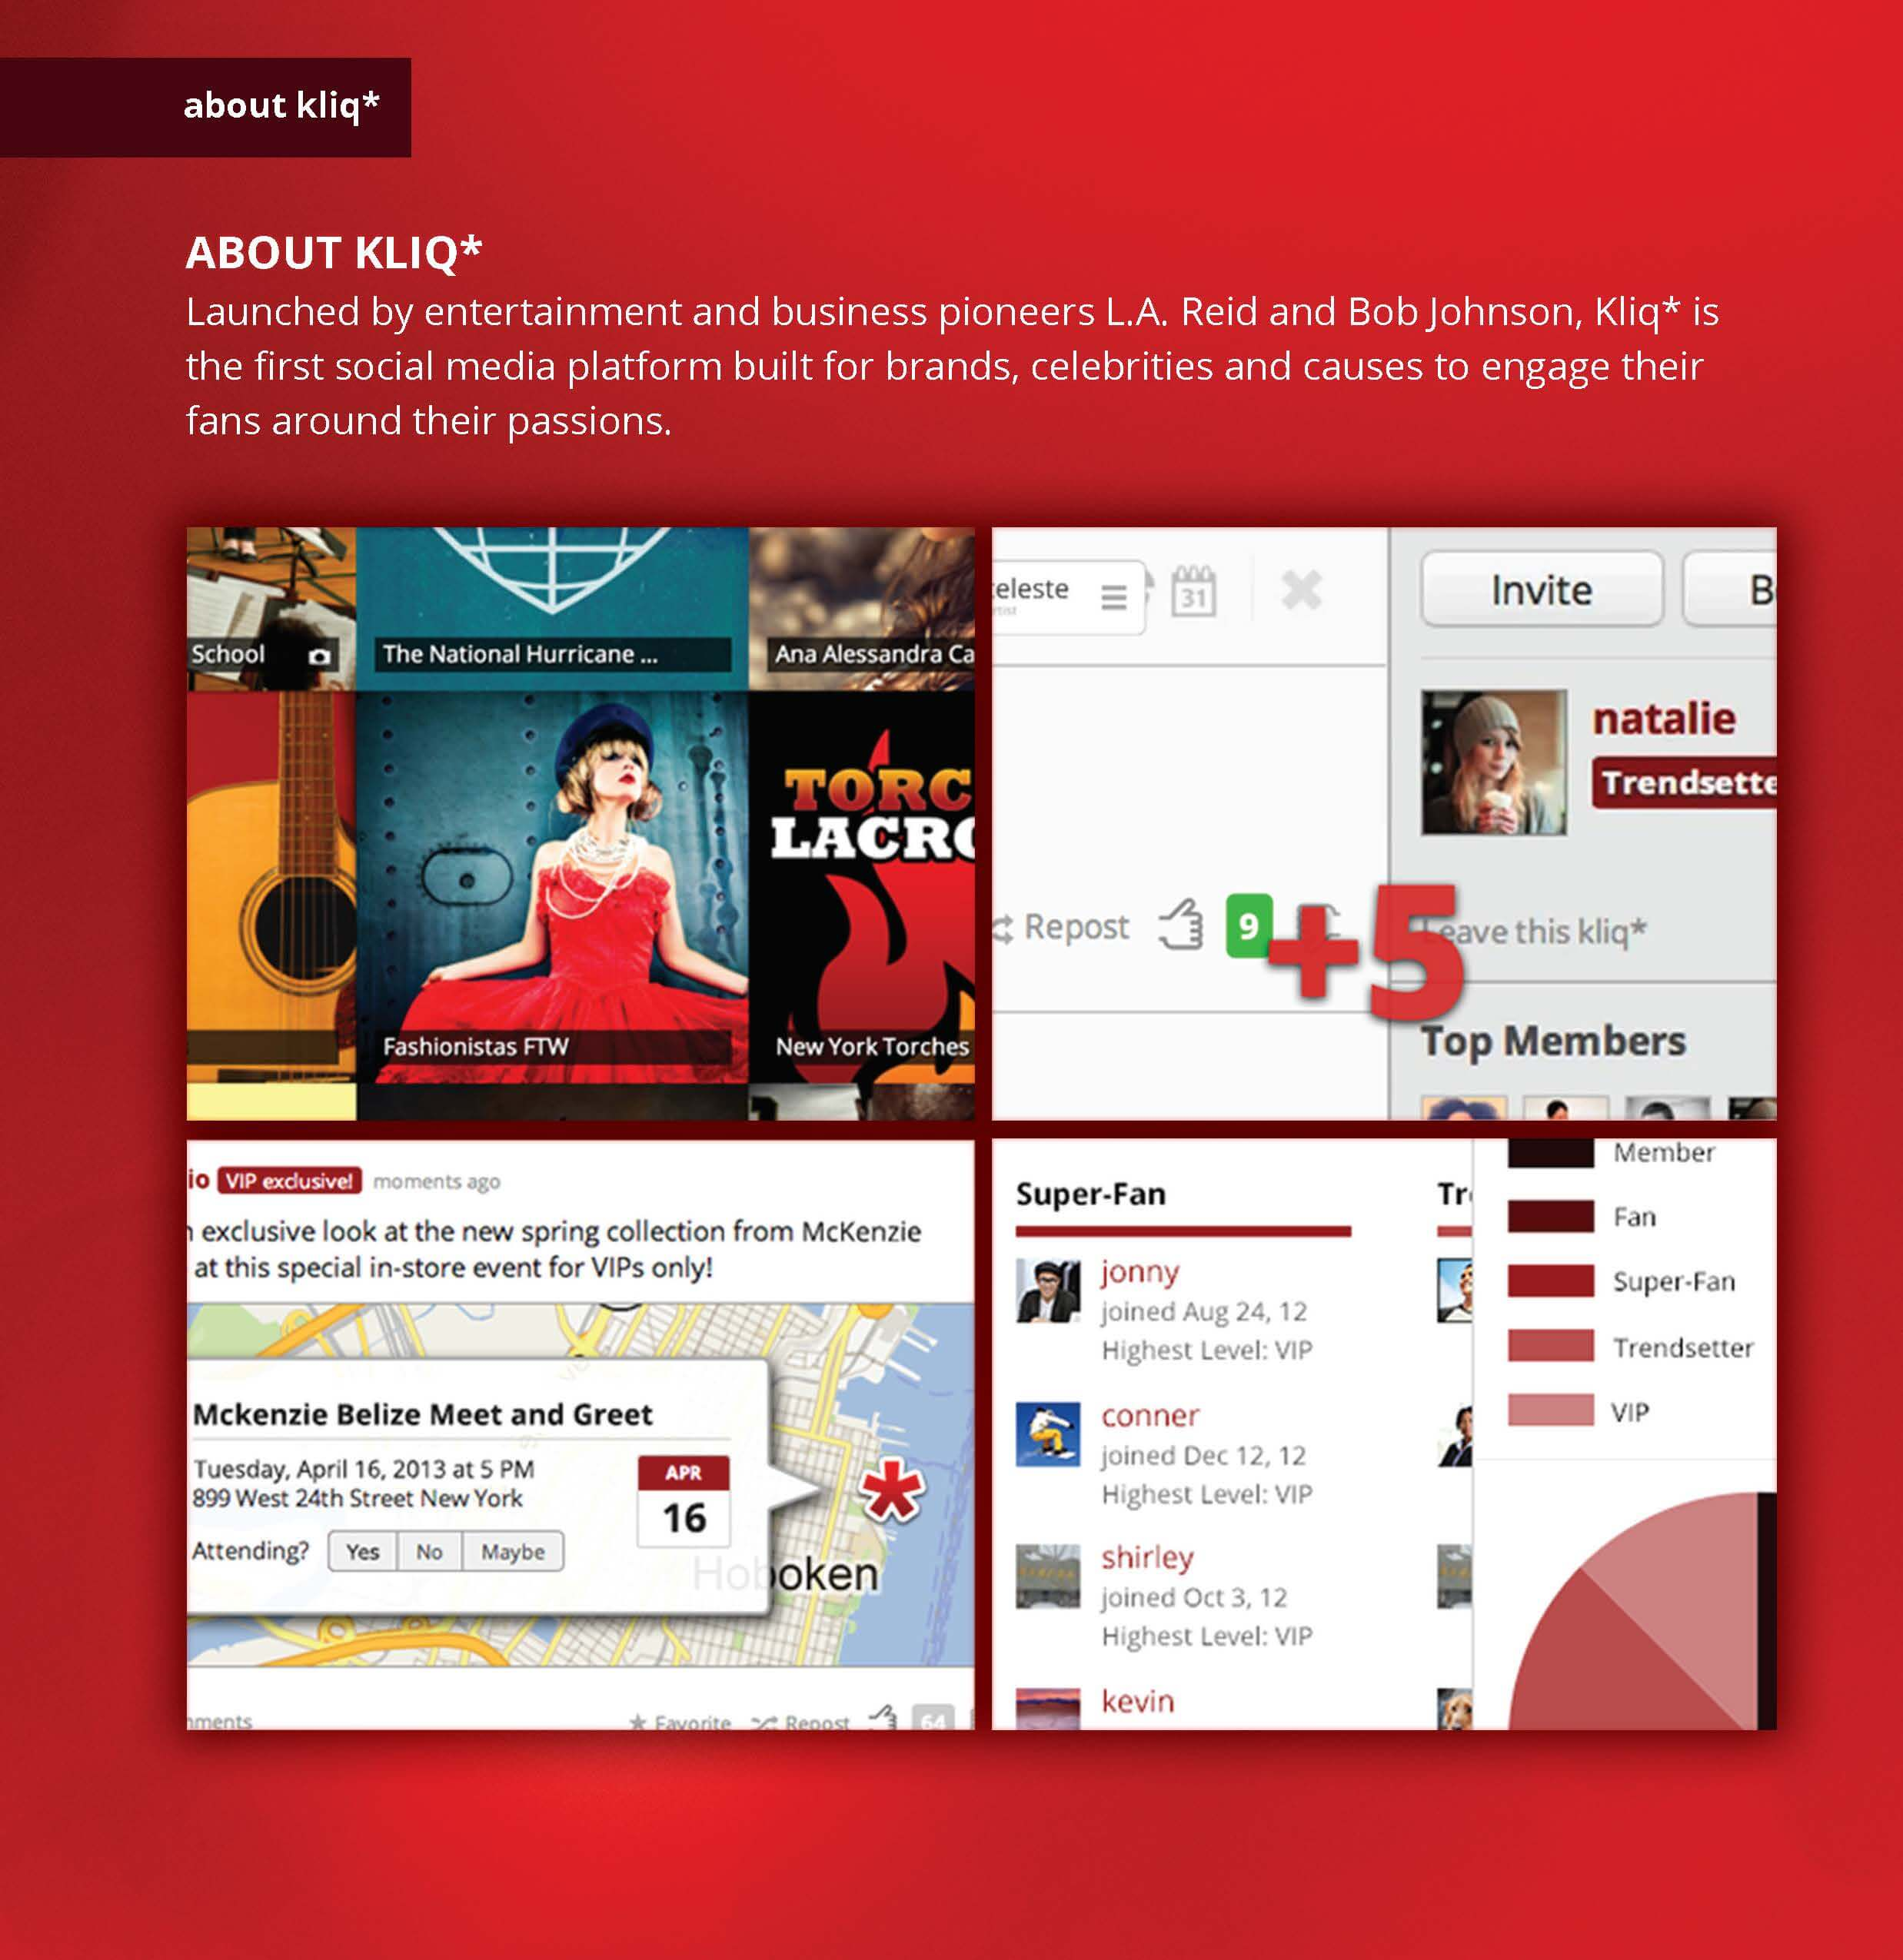
Kliq* Promotional Package
UI/UX design
Designed a promotional package for a new social media platform. Kliq* aimed to reinvent the online fan club, providing a place for businesses and artists to engage fans in the right place at the right time, forging valuable and lasting interactions.

Slide 11
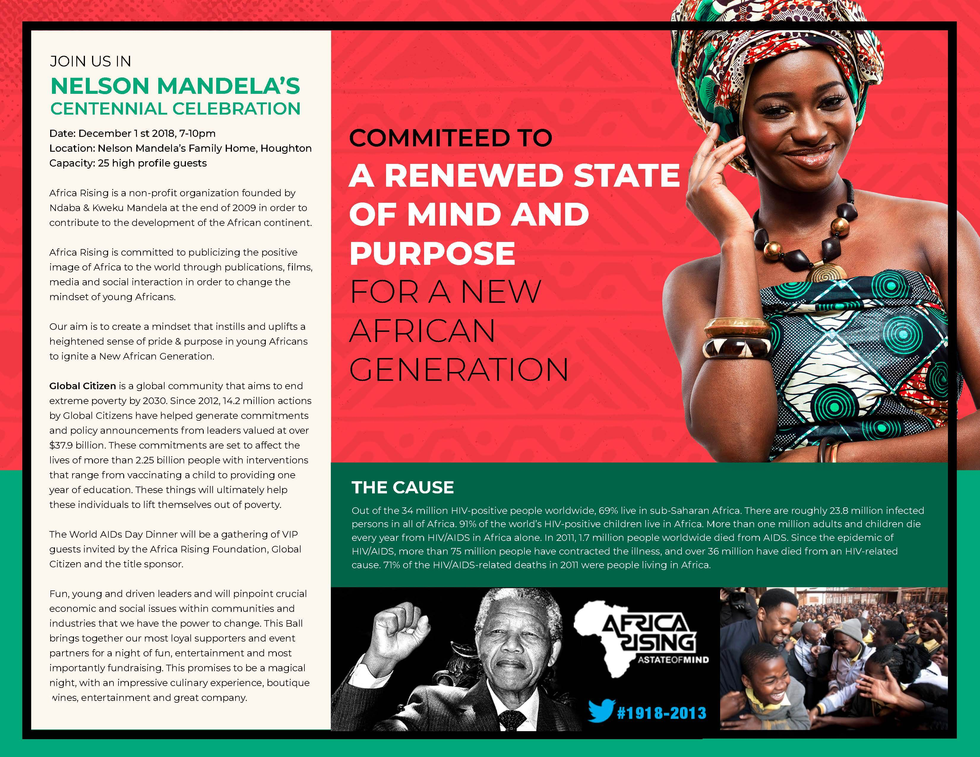
“Nelson Mandela Celebration” CAMPAIGN POSTER
PRINT design
Designed a poster for the Africa Rising “Nelson Madela’s Centennial Celebration”

